Slide 1



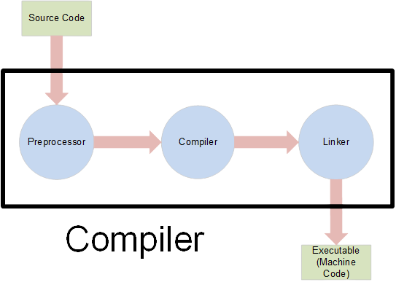
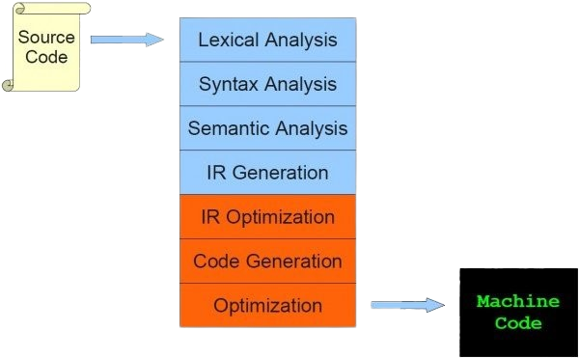
WHAT IS COMPILER ???
HOW IT
WORKES
???
Hey!
You are a programmer!!!
You should know:
Compiler is just a Translator
Only error-free source code is executable
High level
language
High level
language

Slide 2
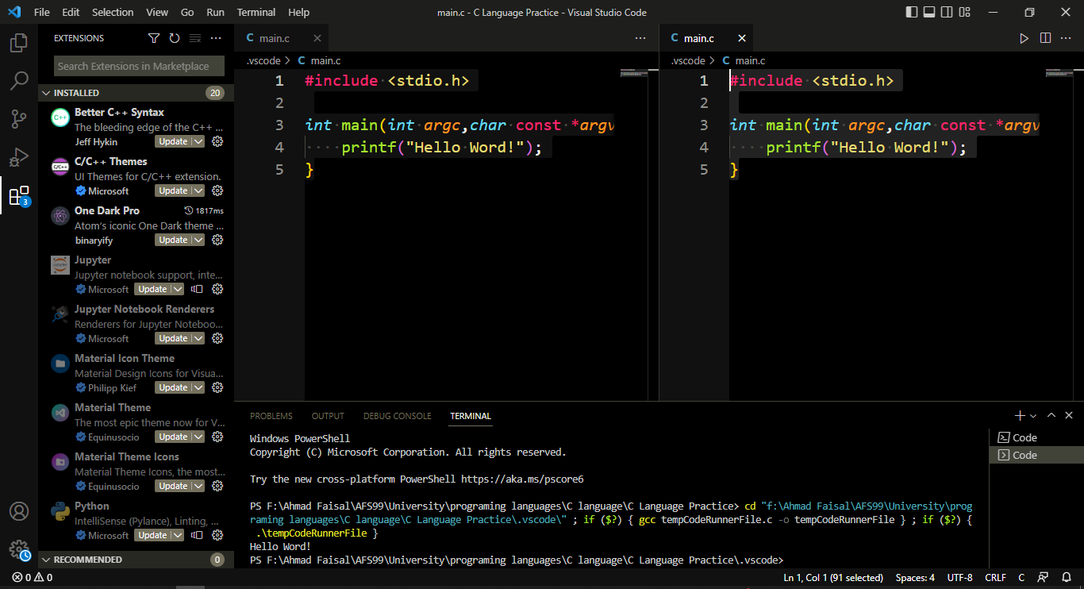
IDE
Integrated Development Environment
Facilitate
But how?
Debugging
Creating
Packaging
It increases developer productivity by combining capabilities
Editing
Building
Testing

Slide 3
THANK FOR WATCHING
Like and share the video
Drop related question if any
Subscribe and click the bell button for more updates.
Instagram
Facebook
TikTok
Telegram

